Slide 1

SUMMER INTERNSHIP PROJECT · IIT JAMMU
FreelanceFlow AI
AI-Powered Freelancing Business Automation Platform
Presented by Ashish Kumar · B.Tech Computer Science Engineering (AI & ML)

Slide 2
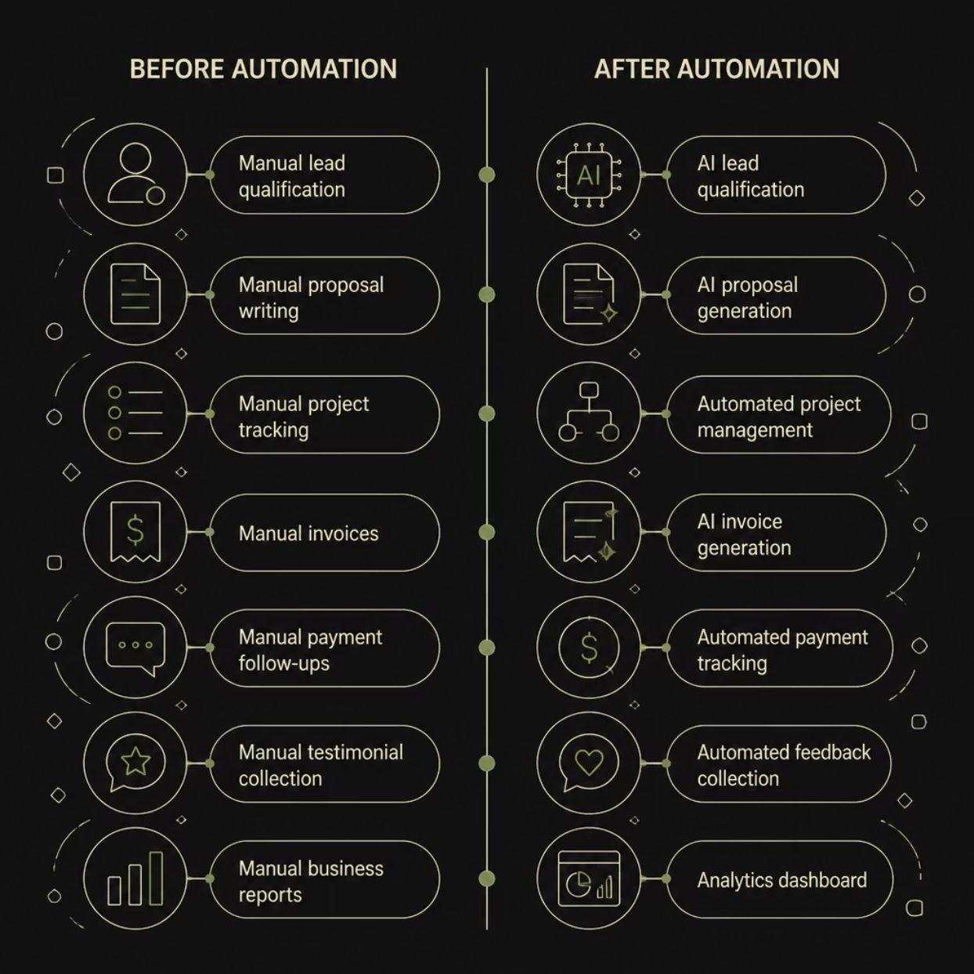

PROBLEM STATEMENT
The Freelancer's Productivity Gap
Before Automation
Manual lead qualification
Proposal writing from scratch
Manual project tracking
Invoice creation & follow-ups
Payment reminders
Testimonial collection
Manual business reports
After Automation
AI-powered lead qualification
AI-generated proposals
Automated project management
AI invoice generation
Automated payment tracking
Automated feedback collection
Real-time analytics dashboard
Core Problem: Freelancers spend significant time on repetitive administrative tasks instead of delivering value to clients.

Slide 3
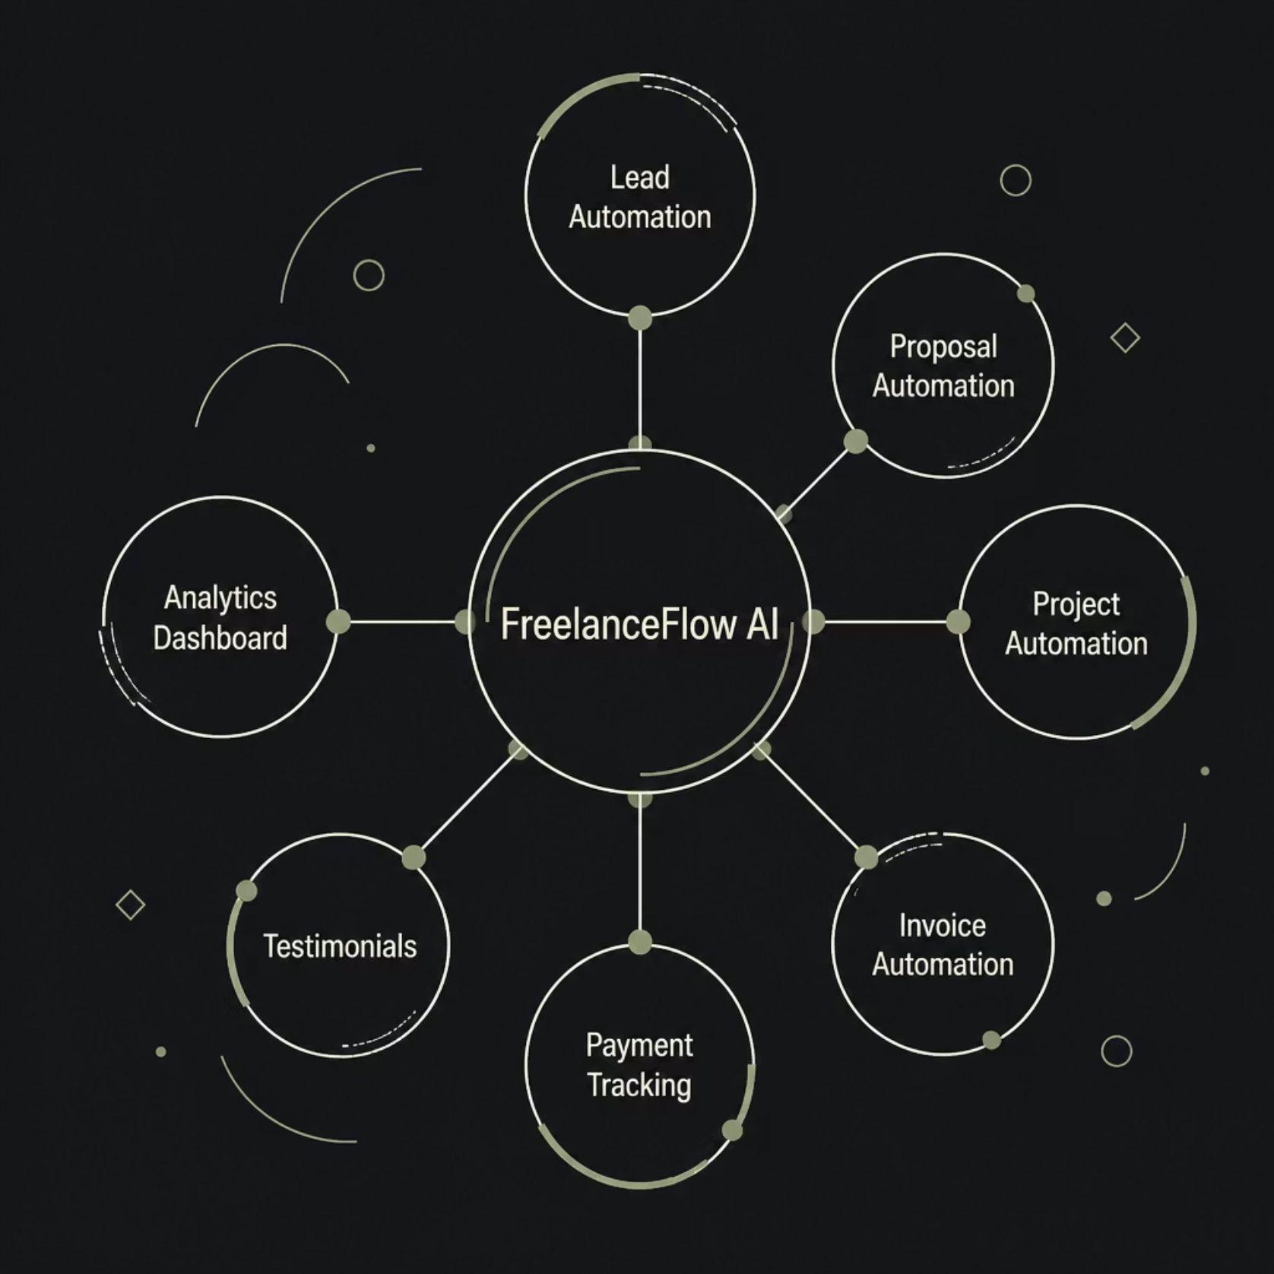
PROJECT OBJECTIVES
Automating the Complete Freelance Lifecycle
FreelanceFlow AI eliminates manual overhead across every stage of a freelance engagement — from first contact to final payment — using AI and intelligent workflow automation.
"To automate the complete freelance business lifecycle using Artificial Intelligence and Workflow Automation."

Slide 4

SYSTEM ARCHITECTURE
Overall Architecture
Intake & Qualification
Delivery & Insights
Central DB & Automation
Google Forms captures client intake data, which flows into a centralized Google Sheets database. Six orchestrated n8n workflows — powered by OpenAI GPT, Gmail, Google Drive, and Cron schedulers — process each stage of the freelance lifecycle automatically and sequentially.

Slide 5
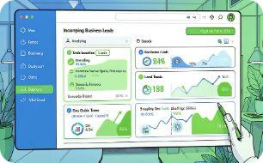
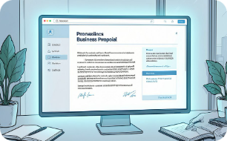
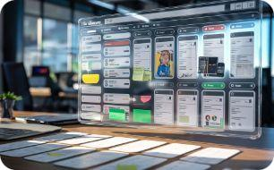
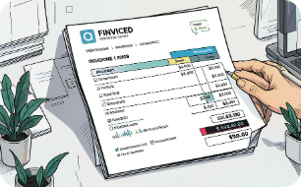
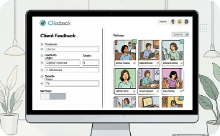
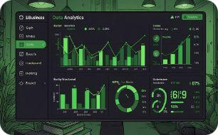
WORKFLOW OVERVIEW
Six Intelligent Workflows
WF-01 · AI Lead Qualification
WF-02 · Proposal Generator
WF-03 · Project Management
WF-04 · Invoice Automation
AI drafts personalized proposals from lead data, exported as polished PDFs.
Generates and dispatches invoices on project completion with automated reminders.
GPT scores and prioritizes incoming leads, routing qualified prospects automatically.
Auto-creates tasks, tracks milestones, and sends client updates on schedule.
WF-05 · Feedback & Portfolio
WF-06 · Business Analytics
Aggregates performance data into a real-time business intelligence dashboard.
Collects testimonials post-project and updates the portfolio automatically.

Slide 6








TECHNOLOGY STACK
Built With Best-in-Class Tools
n8n Cloud
OpenAI GPT
Orchestrates all six workflows with visual automation and API integrations.
Generates proposals, qualifies leads, and produces contextual business content.
Google Sheets
Google Drive
Central relational database across 11 interconnected sheets.
Stores proposals, invoices, and project deliverables with automated organization.
Google Forms
Gmail
Captures client intake and feedback data as workflow triggers.
Sends proposals, invoices, and notifications via automated email sequences.
JavaScript
HTTP APIs
Custom logic for data transformation and conditional workflow branching.
Connects external services, webhooks, and third-party integrations.

Slide 7
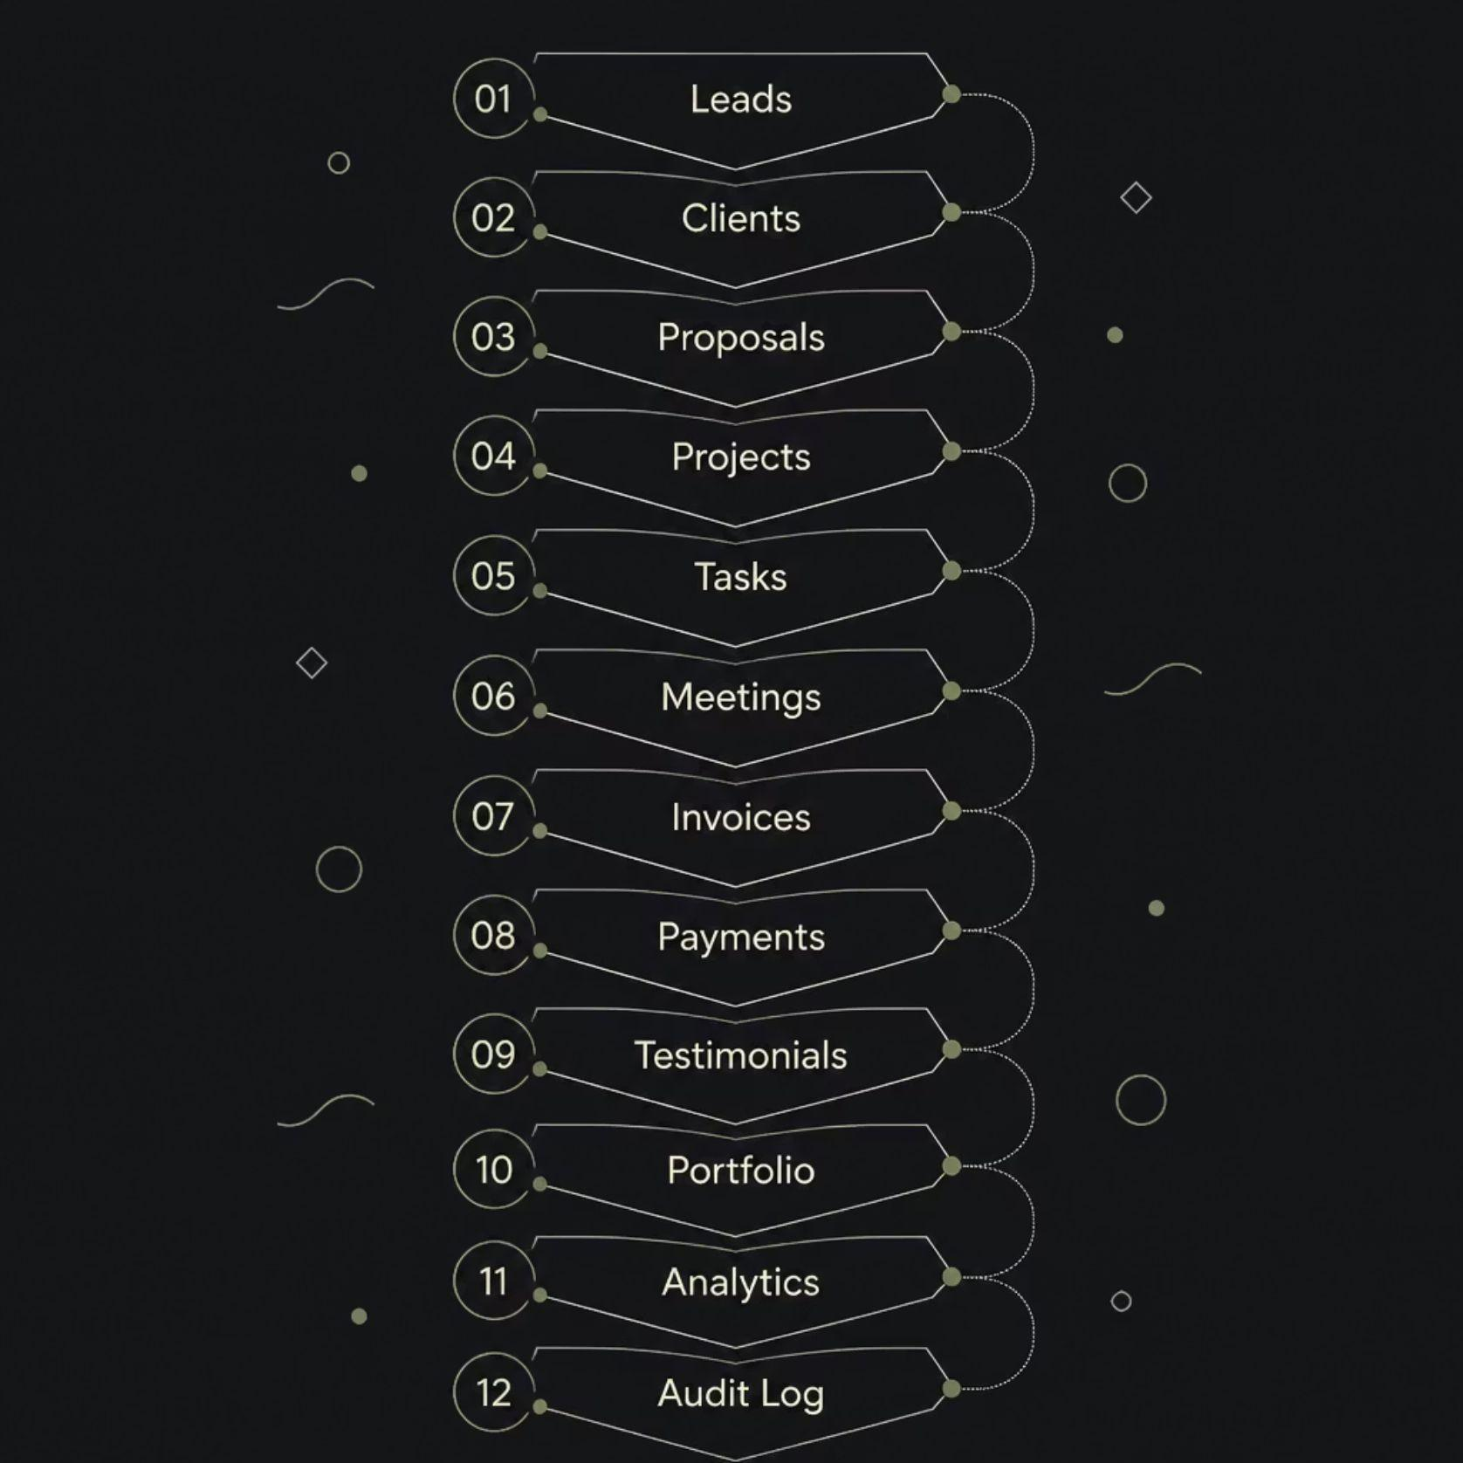
DATABASE DESIGN
Unified Data Architecture
All workflow data flows through a centralized Google Sheets database — 11 interconnected sheets forming a unified data layer. Each entity links to the next, ensuring full traceability from first lead to final payment.

Slide 8
RESULTS & ACHIEVEMENTS
By the Numbers
6
90+
Automated Workflows
Workflow Nodes
End-to-end lifecycle coverage
Complex automation logic
11
100%
Google Sheets
Automated Pipeline
Interconnected data stores
Zero manual intervention
AI Integrated
Proposal PDF Generation
OpenAI GPT embedded across all core workflows
Professional proposals auto-generated and delivered
Invoice Automation
Business Dashboard
Timely, accurate billing with automated reminders
Real-time analytics and performance insights

Slide 9
FUTURE SCOPE
The Road Ahead
Phase 1
1
WhatsApp Integration
Automated client communication and notifications via WhatsApp Business API.
2
Phase 2
Stripe Payments
Seamless payment processing and subscription management.
Phase 3
3
Client Portal
Dedicated dashboard for clients to track project status and deliverables.
4
Phase 4
Slack Integration
Team collaboration and real-time project alerts in Slack.
Phase 5
5
AI Chatbot
Conversational AI assistant for client onboarding and support queries.
6
Phase 6
Predictive Analytics
ML-powered revenue forecasting and workload predictions.

Slide 10
Conclusion
FreelanceFlow AI demonstrates how Artificial Intelligence combined with Workflow Automation can fully automate the freelance business lifecycle — from lead to payment — freeing freelancers to focus on what matters most: delivering exceptional work.
🎓 University Evaluation
🔬 Technical Viva
🚀 Startup Ready
Thank You
Questions are welcome.
Ashish Kumar · B.Tech CSE (AI & ML) · IIT Jammu Summer Internship

